Slide 1



OPIM - 5671
Sales Spectrum Mining Insights for Retail Growth
TEAM 8
Page - 1

Slide 2

TABLE OF CONTENT
BUSINESS PROBLEM
DATA DESCRIPTION
THE PROCESS
FINAL MODEL
MODEL INSIGHTS
RECOMMENDATIONS
Page - 2

Slide 3




BUSINESS PROBLEM
01
SALES FORECASTING
02
INVENTORY MANAGEMENT FOR OFFICE SUPPLIES & FURNITURE SALES
03
TARGETED REGION PRIORITIZATION BY REGIONAL SALES FORECASTING
Page - 3

Slide 4



DATA PREPARATION
THE PROCESS
DATA CLEANING
DATA SPLITTING
ACCUMULATION
DATA EXPLORATION
DECOMPOSITION ANALYSIS
AUTOCORRELATION ANALYSIS
UNIT ROOT TEST ANALYSIS
MODELLING & FORECASTING
EXPLORATION DRIVEN MODELLING
MODEL COMPARISON AND SELECTION
Page - 4

Slide 5
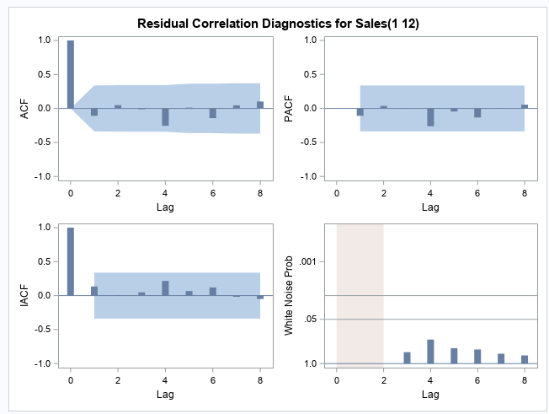
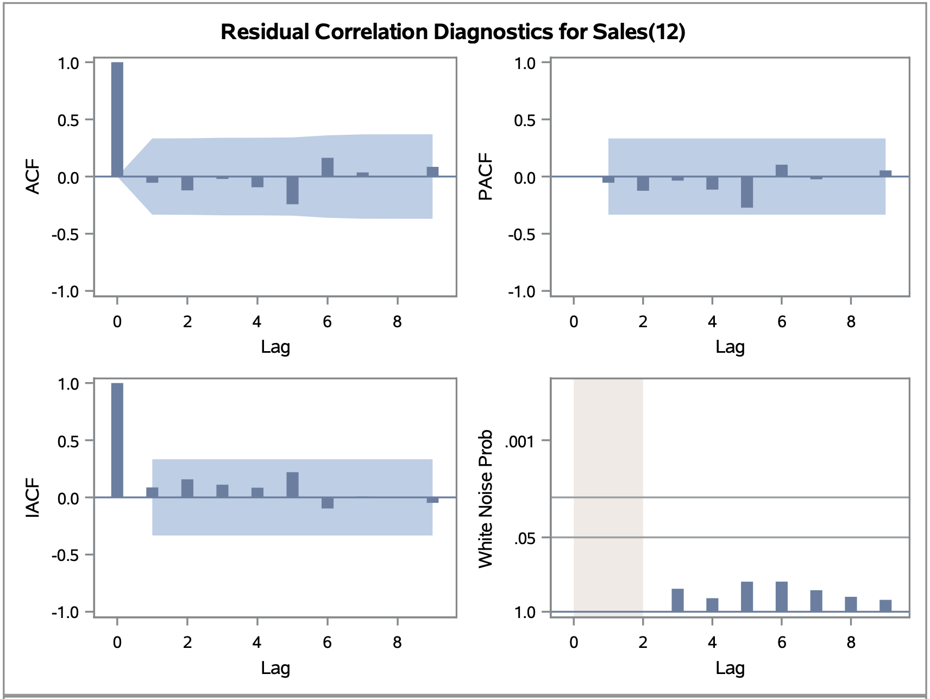
FINAL MODELS
CATEGORY-WISE SALES
1.1 OFFICE SUPPLIES
1.2 FURNITURE
SARIMA(1,1,1)(0,1,0)
SARIMA(1,0,1)(0,1,0)
AIC | 725.8323
SBC | 730.4983
MAPE | 14.14
AIC | 707.4930
SBC | 712.2436
MAPE | 23.81
Page - 5

Slide 6
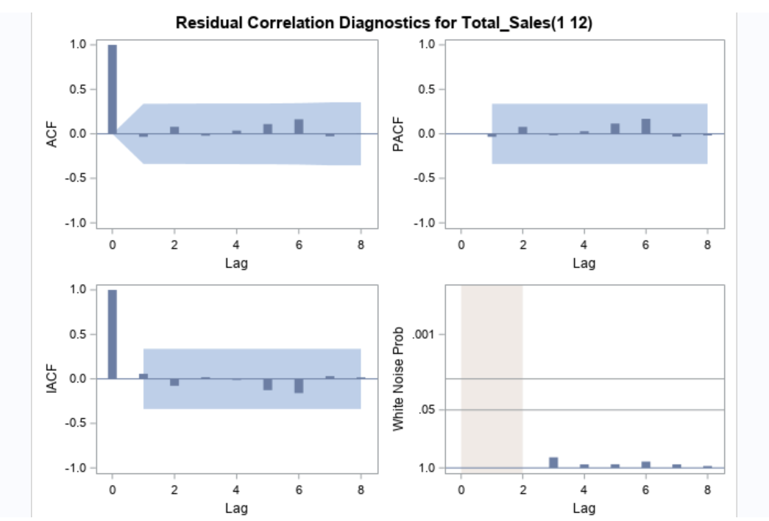
FINAL MODELS
2. WESTERN REGION-WISE SALES
SARIMA(1,1,1)(0,1,0)
AIC | 710.6
SBC | 715.3
MAPE | 19.26
Page - 6

Slide 7
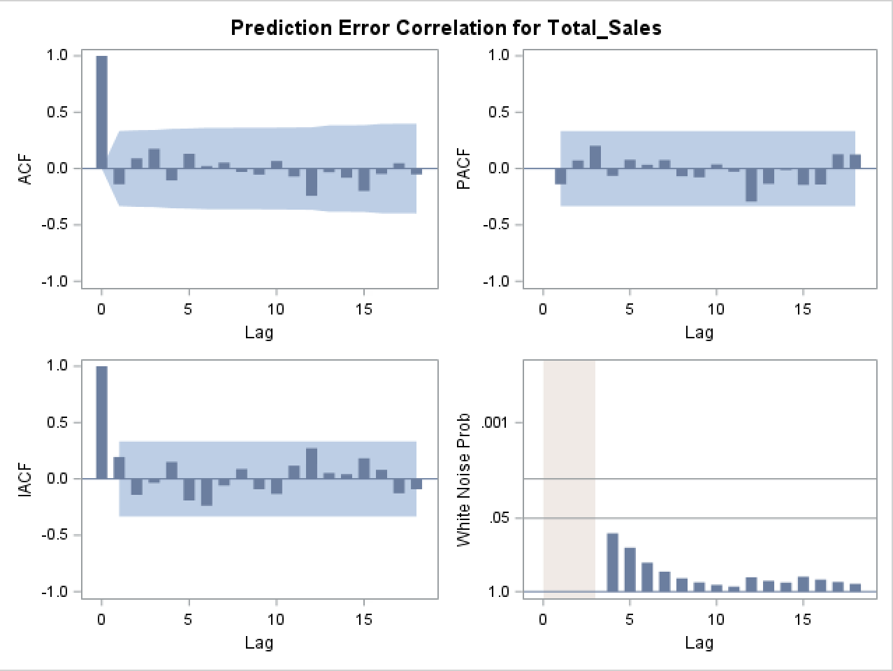
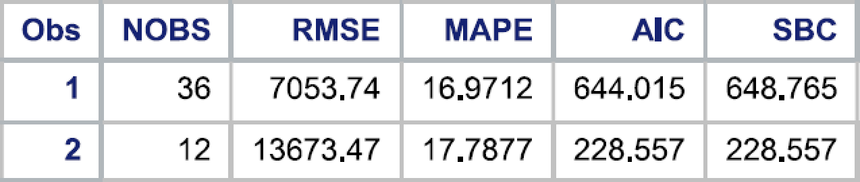
FINAL MODELS
3. TOTAL SALES
ESM (Winters Additive)
Page - 7

Slide 8
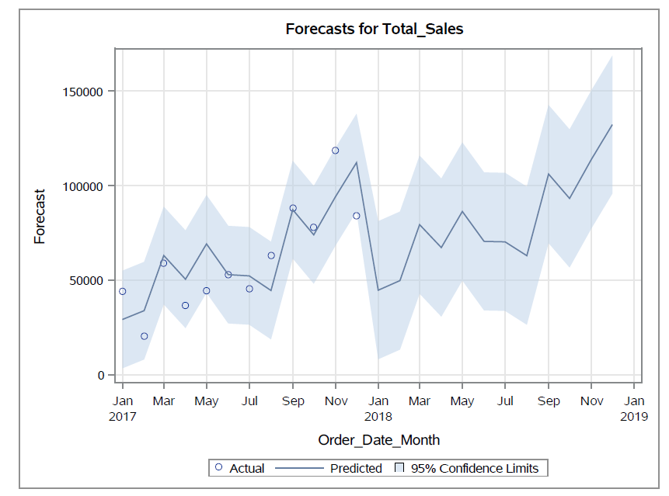
MODEL INSIGHTS
OVERALL SALES
Upward Trend from JAN 2018
Peak Sales - March,May, September and December
Slow sales - February , April, August
Page - 8

Slide 9
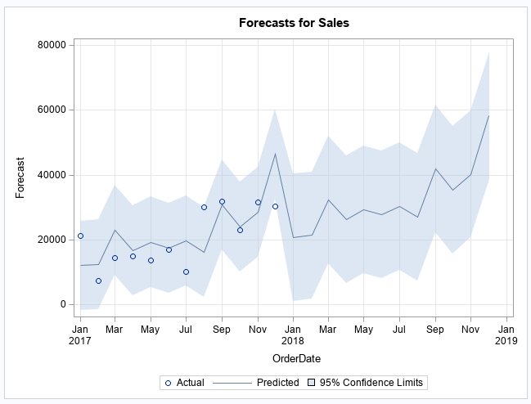
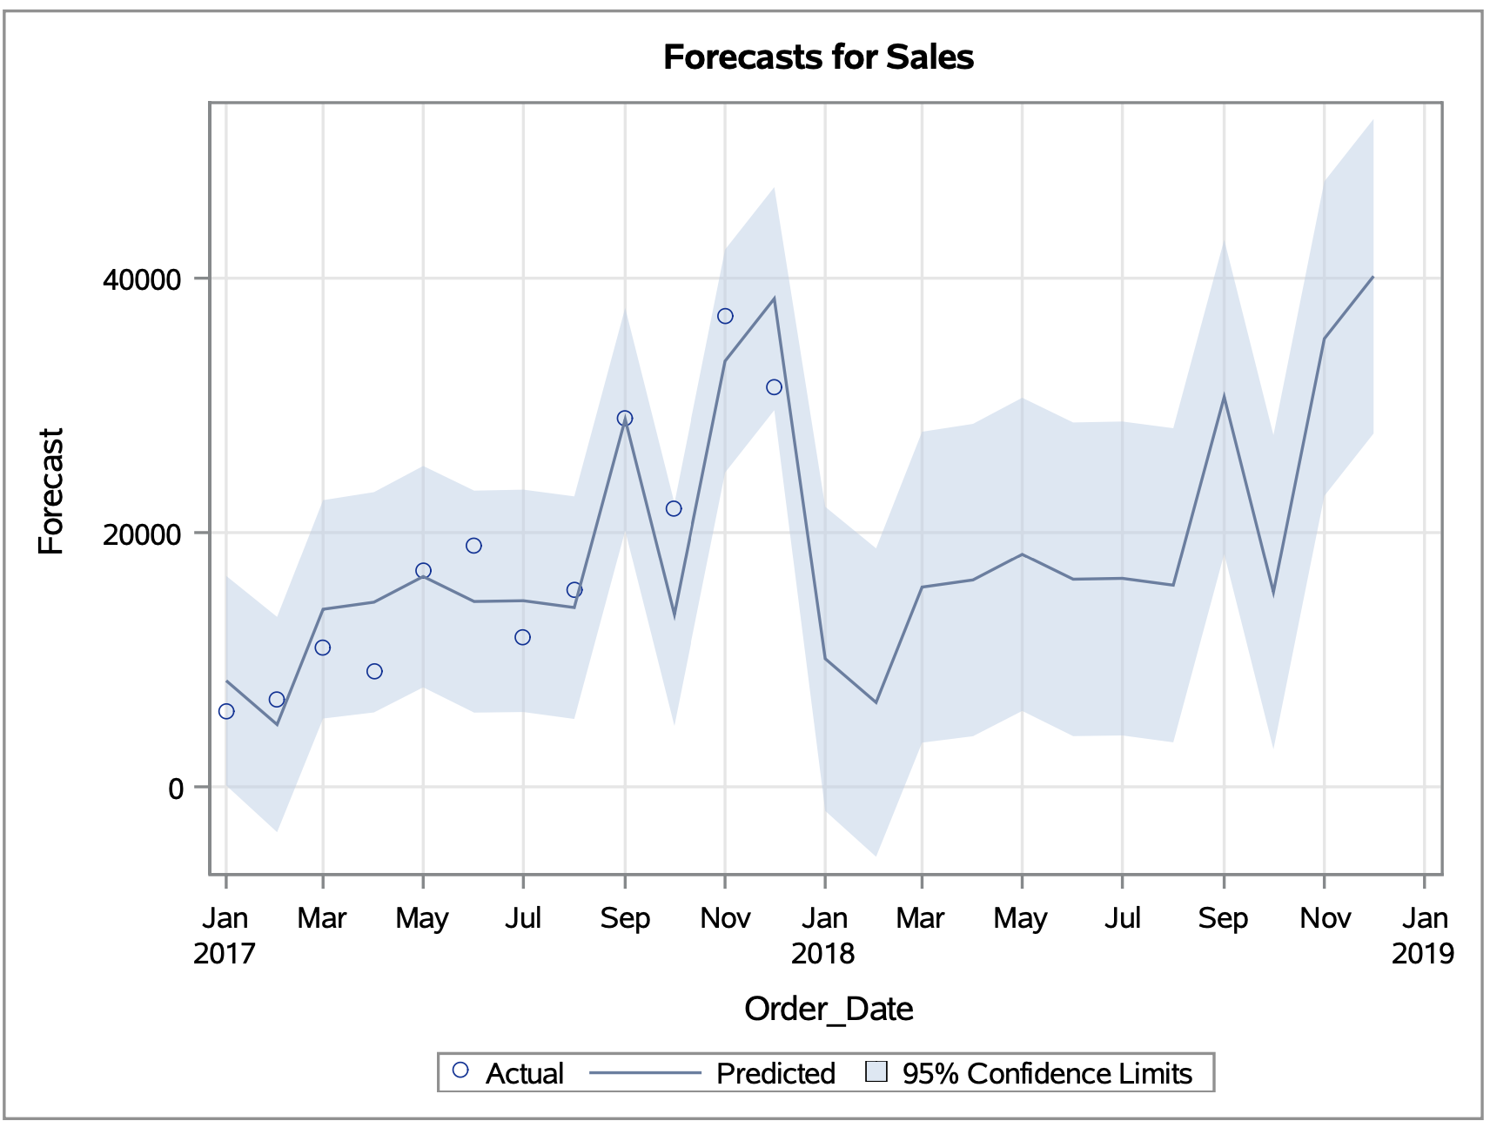
MODEL INSIGHTS
CATEGORIES COMPARISON(FURNITURE VS OFFICE SUPPLIES)
Upward Trend from JAN 2018
Peak Sales - Mar, Jun, Sep & Dec
Slow sales - Feb, Apr, Aug & Oct
Upward Trend from JAN 2018
Peak Sales - May, Sep & Nov
Slow sales - Feb, Apr, Aug & Oct
Page - 9

Slide 10
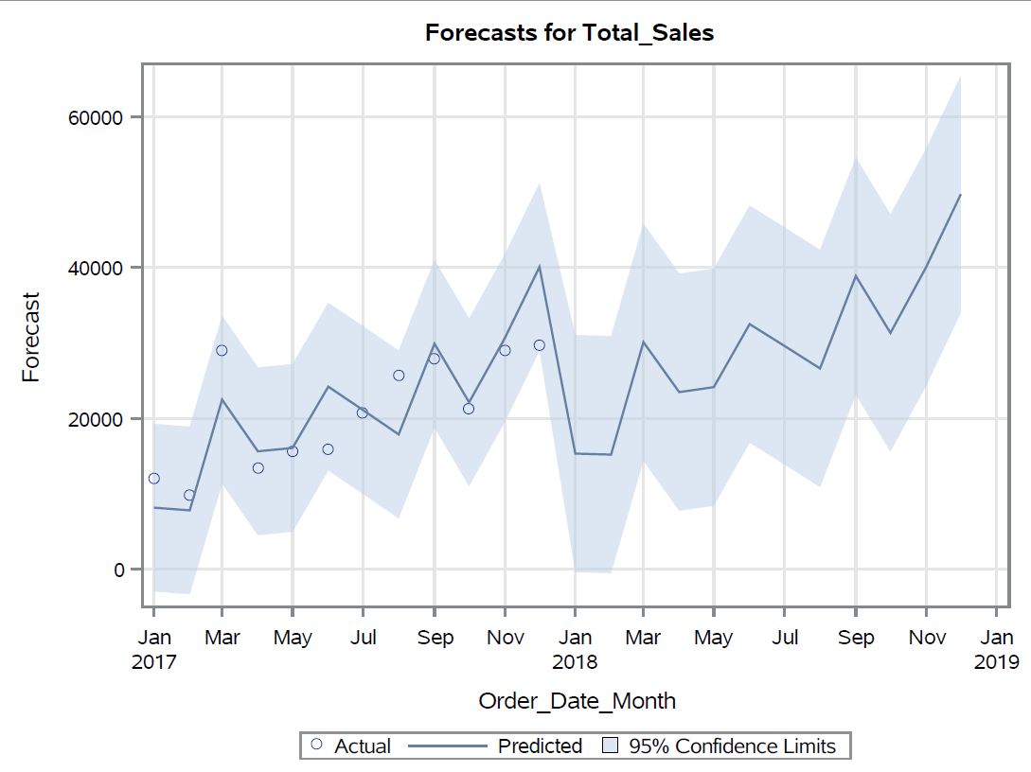
MODEL INSIGHTS
WESTERN REGION SALES ANALYSIS
Upward Trend from JAN 2018
Peak Sales - March,June, September and December
Slow sales - February , April, August, October
Page - 10

Slide 11
BUSINESS RECOMMENDATIONS
Goals 03
Goals 01
Goals 02
Inventory Management to Optimize storage costs and ensure product availability.
Seasonal Marketing Campaigns & Promotions in June, September and December months for Overall Sales Improvement
Implementation of Customer Loyalty programs during slower sales months - February, April and August to encourage repeat purchase
Page - 11

Slide 12
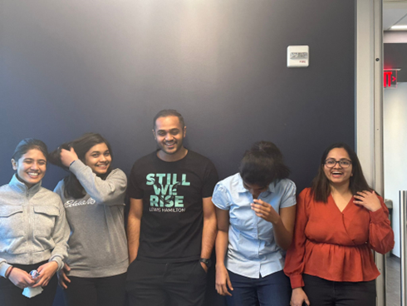
THANK YOU!
Satakshi Deshmukh
Sri Kavya Reddy Narra
Rohit Kamineni
Hema Pradhiksha Dhanapal
Sravya Machavarapu
Page - 12

